Slide 1
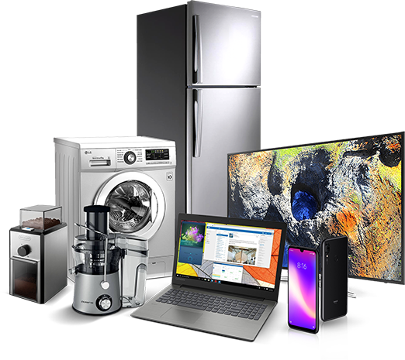
ELECTROMEGA
Ecommerce Electronics Shopping Website
By,
Avinash Kumar
2110991887
G5 - 3rd Year
Faculty - Mr. Lavish Arora

Slide 2
Contents
Our website comprises 20 pages, each serving a specific purpose:
Landing Page
Comparison
Categories
Broad Categories
Product Review
Product Page
Store Locator
Gift Cards
ElectroMega Foundation
Checkout
FAQ
Affiliate Program
Affiliate Tools
Customer Services
Blog
Track Order
About Us
Contact
Login
Signup

Slide 3
INTRODUCTION
Welcome to ElectroMega - Your Ultimate Electronics Shopping Destination
At ElectroMega, we bring you a world of cutting-edge electronics, all in one place. Whether you're a tech enthusiast, a gadget lover, or simply looking for the latest in electronic devices, ElectroMega is your one-stop solution. Our website is built using a combination of advanced technologies, including HTML, CSS, JavaScript, and Bootstrap, to ensure a seamless and responsive user experience.
Explore our extensive range of products and discover the future of electronics today!

Slide 4
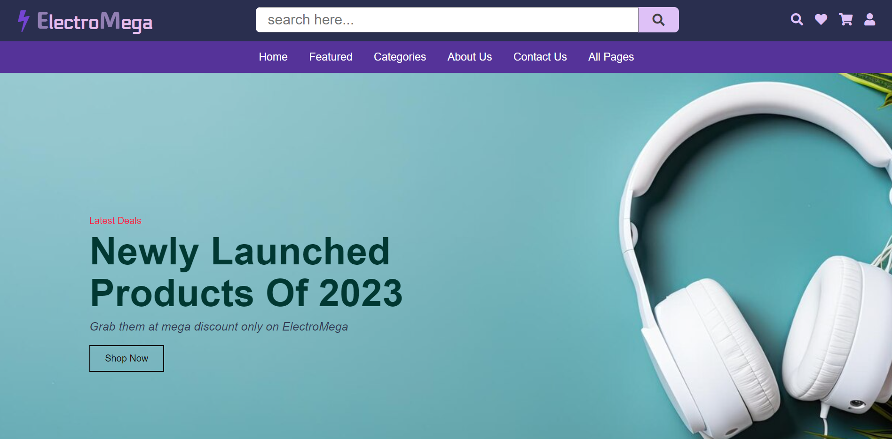
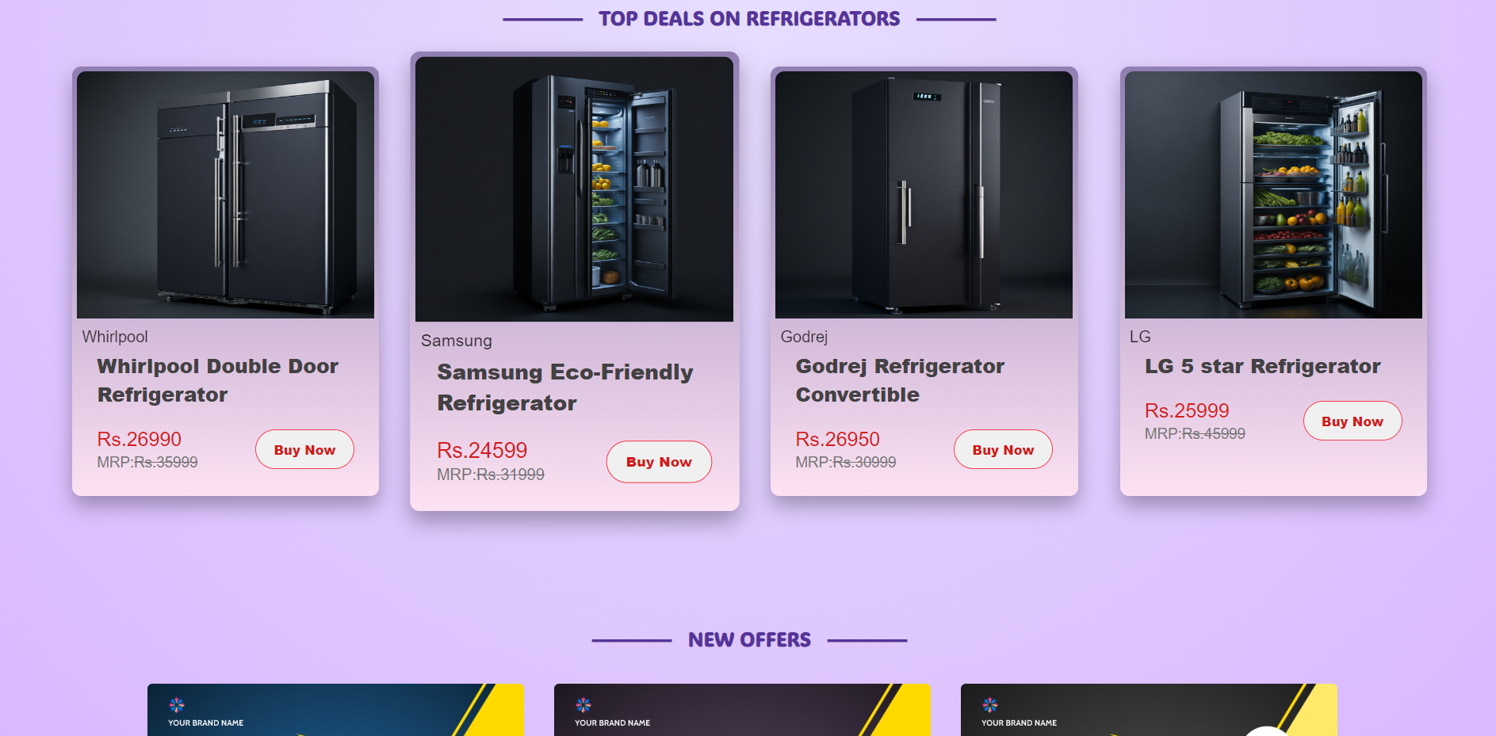
Lading Page
Home Page include the showcase of latest arrivals of electronic items such as fridge, washing machine, TVs etc.
The page has also the use of carousel to showcase various offers on products.
Technologies used - HTML, CSS and Javascript

Slide 5
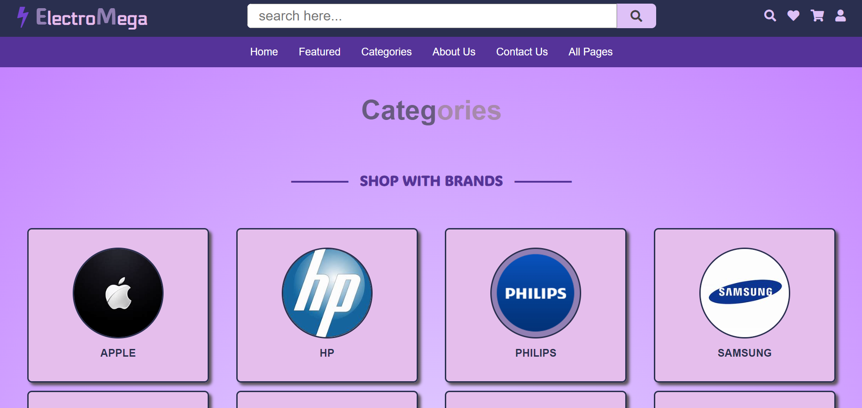
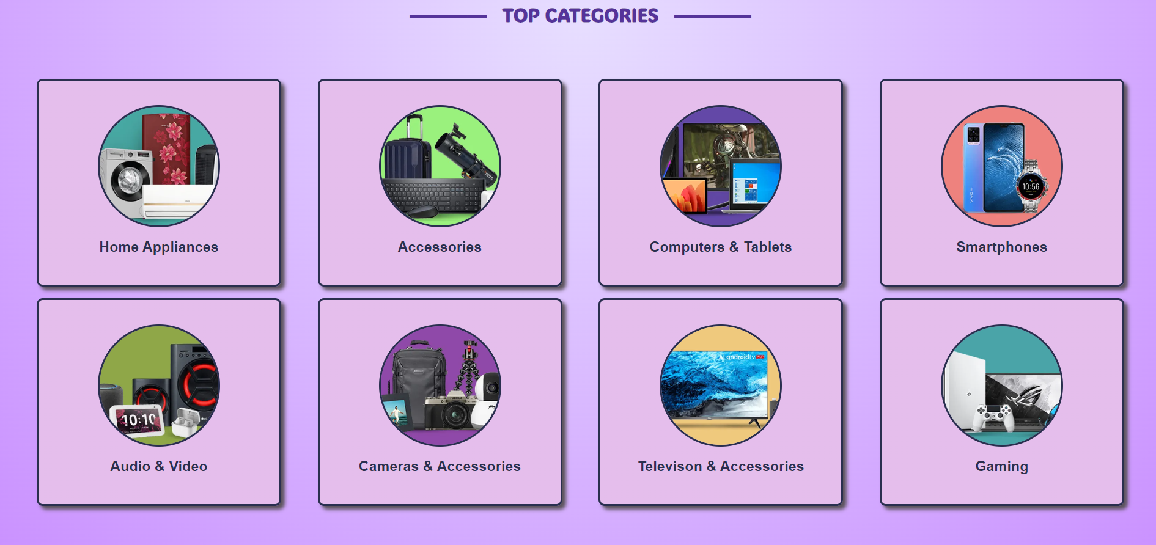
Categories
At ElectroMega, shopping is a breeze. Browse our Categories Page to shop with ease. Explore by brands or categories to find the perfect electronic solutions that match your style and needs. Shop smart with ElectroMega.
Technologies Used - HTML and CSS

Slide 6
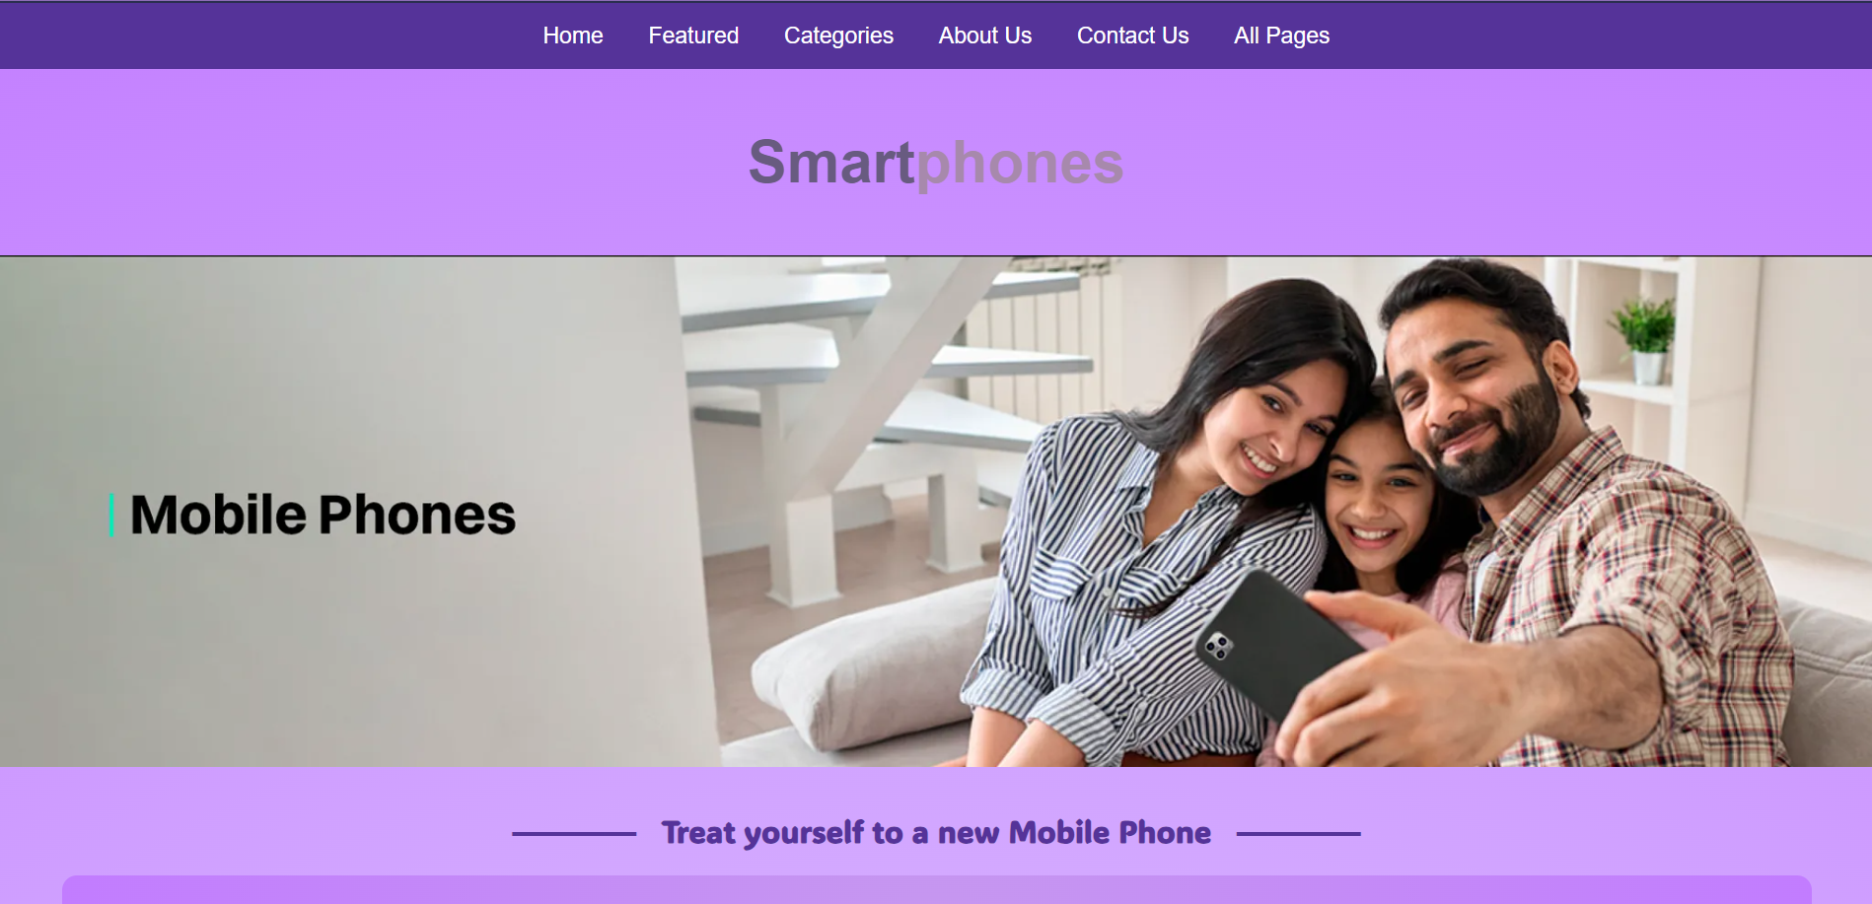
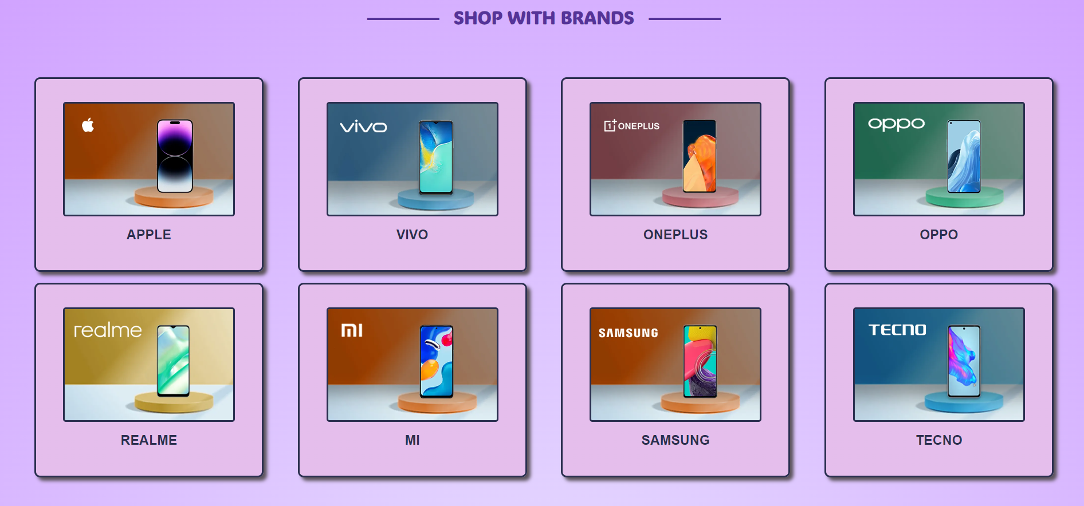
Broad Category
At ElectroMega, we simplify smartphone shopping on our Broad Categories Page. You can shop by brands, making it easy to find your trusted favorites. But we go further – tailor your experience by choosing smartphones for specific use cases. Are you a gaming enthusiast or a photography buff? We've got the perfect smartphone for you. Explore, compare, and discover your ideal smartphone with ElectroMega.
Technologies Used - HTML and CSS

Slide 7
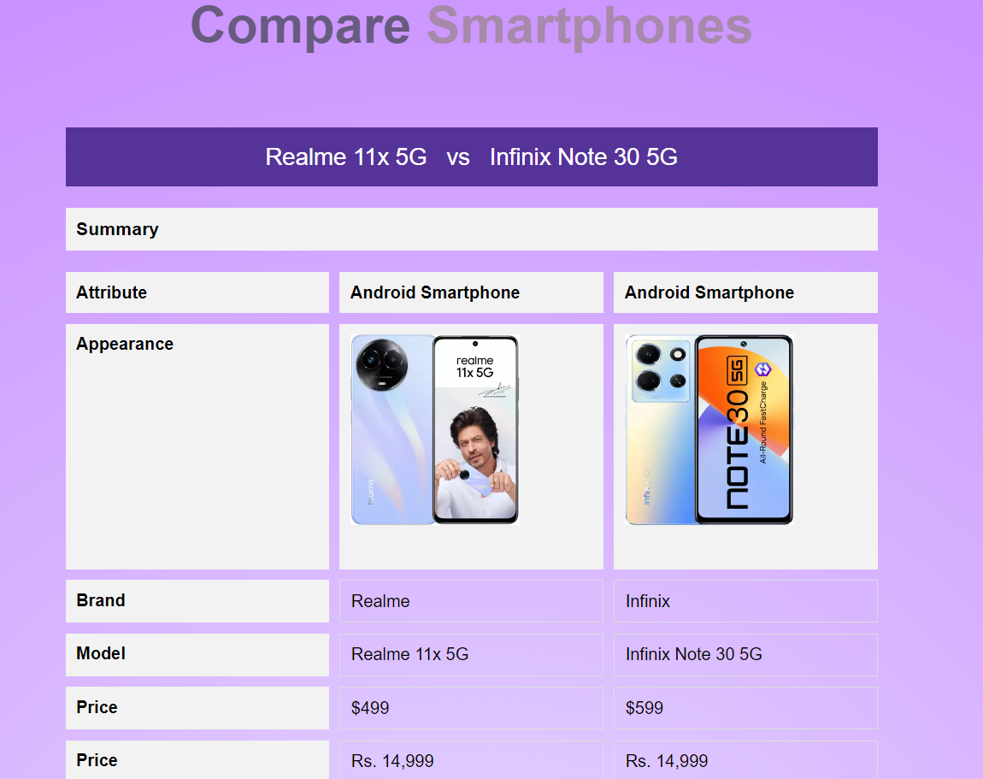
Comparison Page
On comparison page, you can compare latest trending smartphones. Compare smartphones based on various aspects such as price, specifications etc.
This web page is developed with the hep of grid property.
Technologies used - HTML, CSS and Javascript

Slide 8
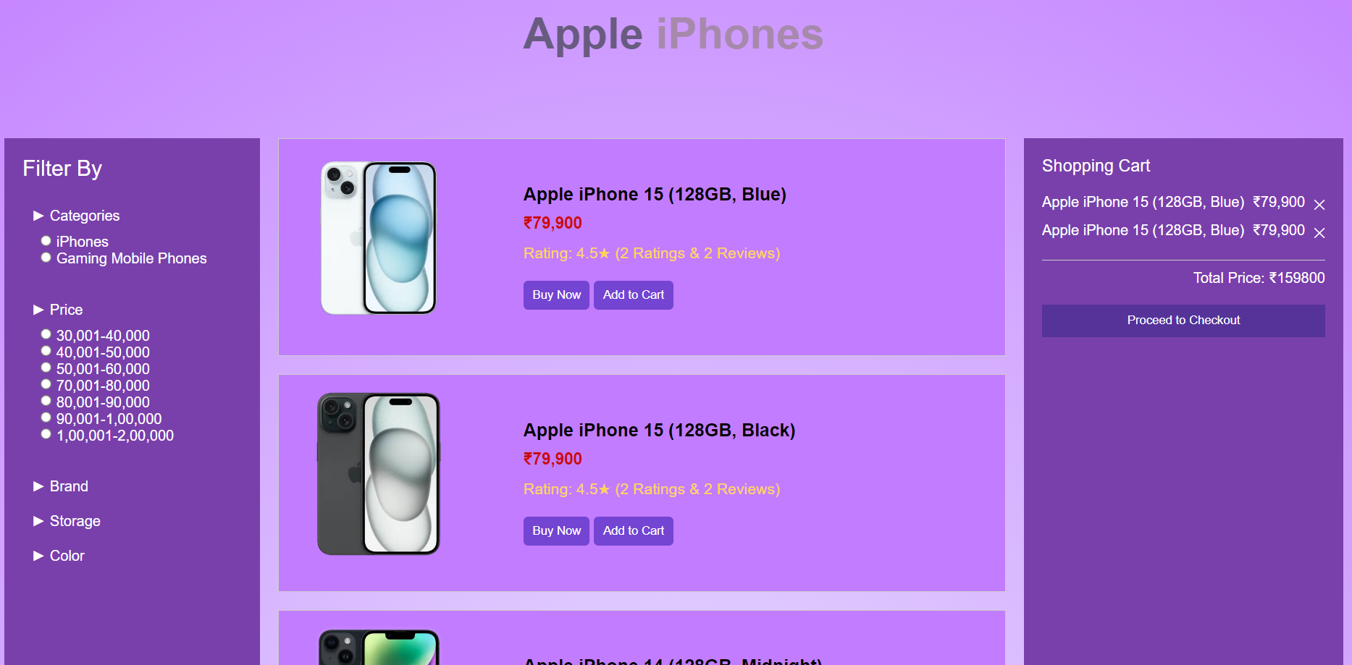
Product Details
If you choose apple iphones in broad category page, the website will redirect you to product details page for apple iphones. You can filter products or add to cart based on your choice. User can also check the totalprice before proceeding to checkout.
Technologies used - HTML, CSS and Javascript

Slide 9
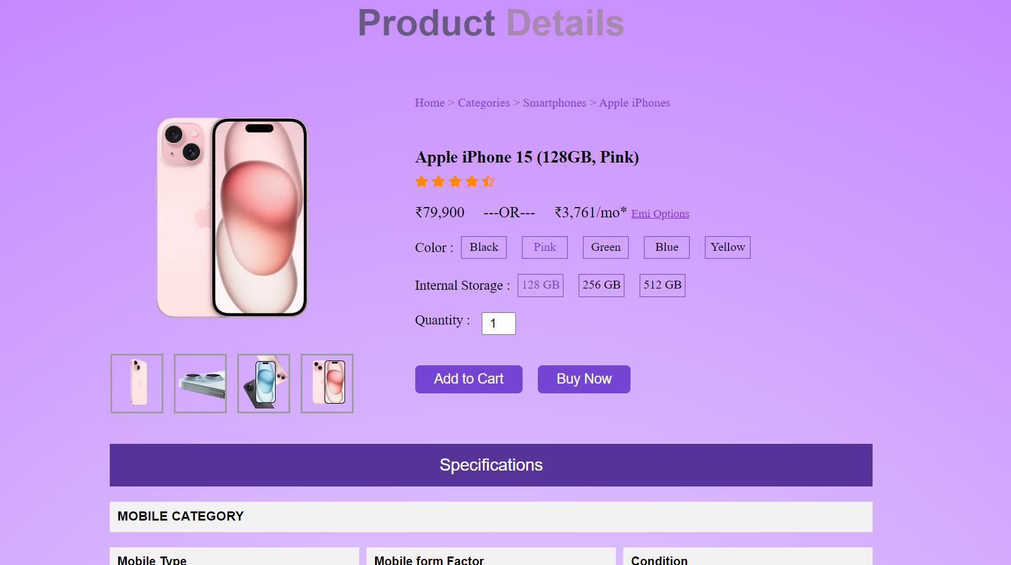
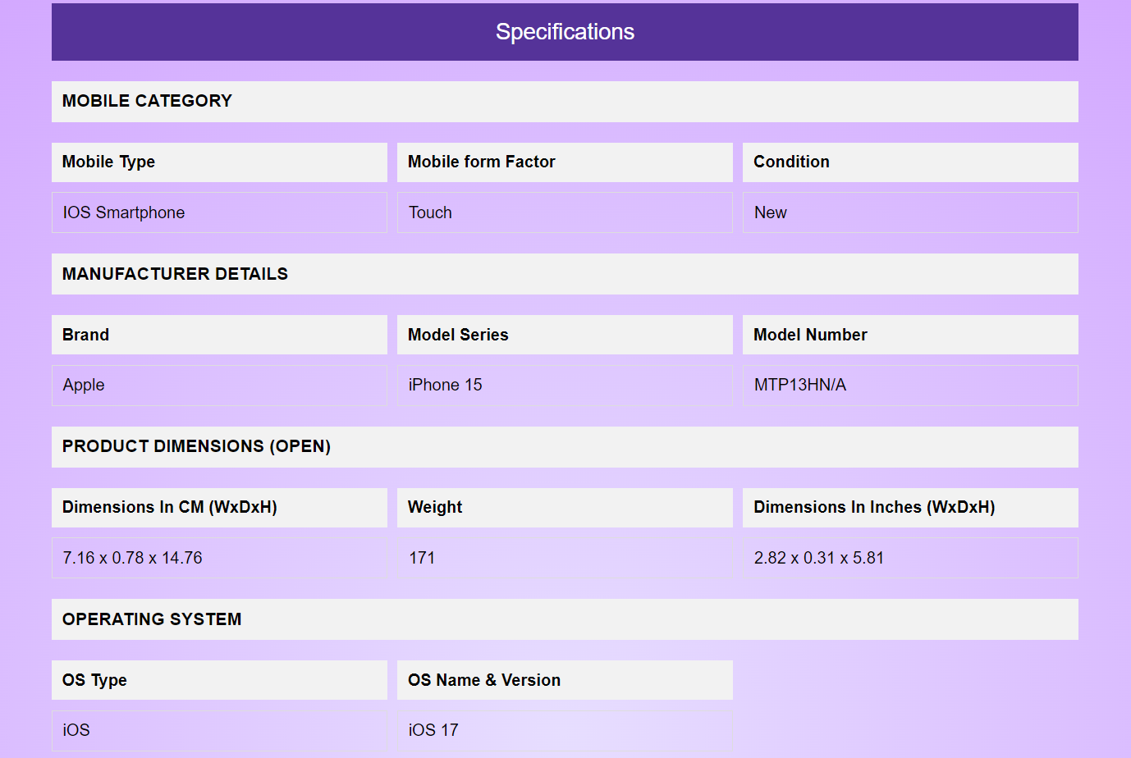
Product Details
User can check the details of the product by clicking on the image or name of the product. Specifications of phones and overview are also displayed.
Technologies used - HTML, CSS and Javascript

Slide 10
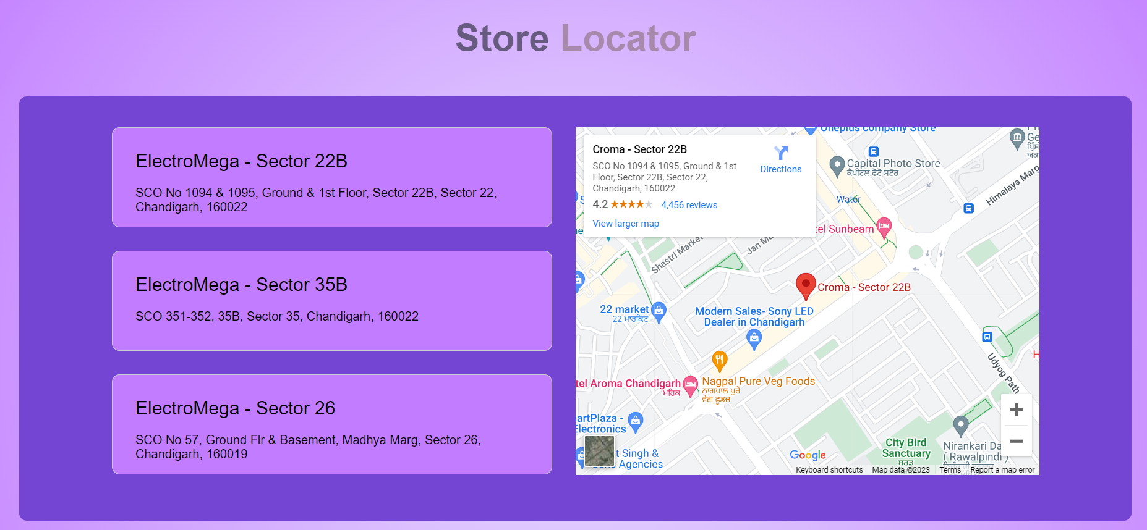
Store Locator
Finding your nearest ElectroMega store is a breeze with our Store Locator Page. We have a network of convenient locations to serve you better. Whether you want to see our products in person, pick up your online order, or seek expert advice, our store locator makes it simple. You can navigate through stores’ map by clicking the store adddress.
Technologies used - HTML, CSS and Javascript

Slide 11
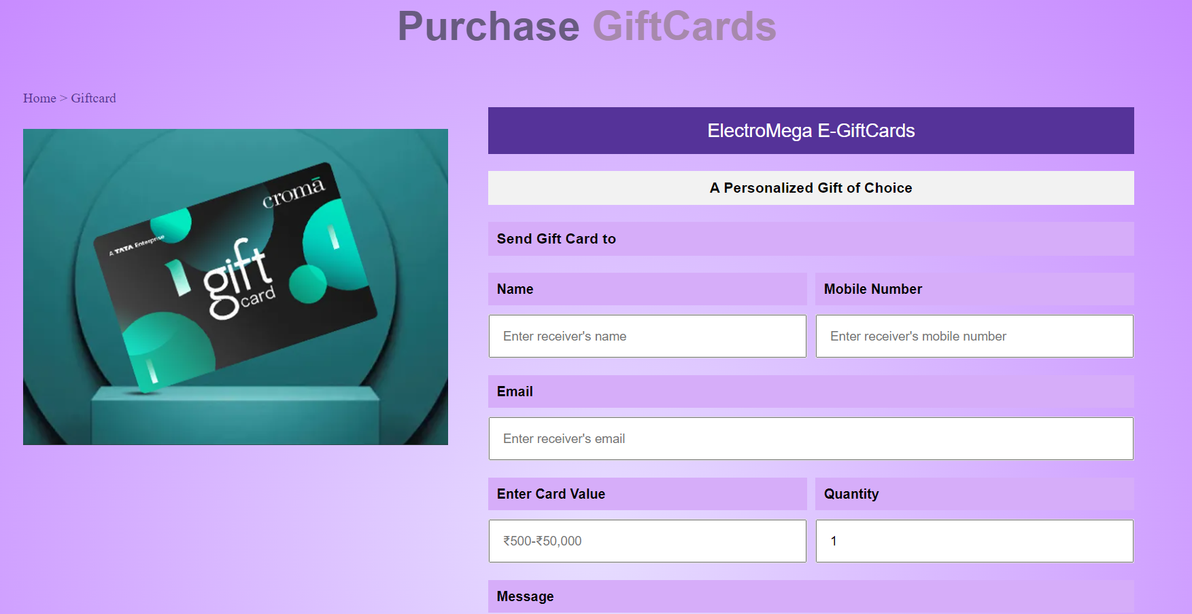
Gift Card Page
At ElectroMega, giving the gift of electronics has never been easier. Our Gift Card Page is your portal to a world of tech surprises. Choose from a range of gift card options, and let your loved ones explore their electronic dreams. Plus, our gift cards can also generate receipts, making it hassle-free for both the giver and the receiver.
Technologies used - HTML, CSS and Javascript

Slide 12

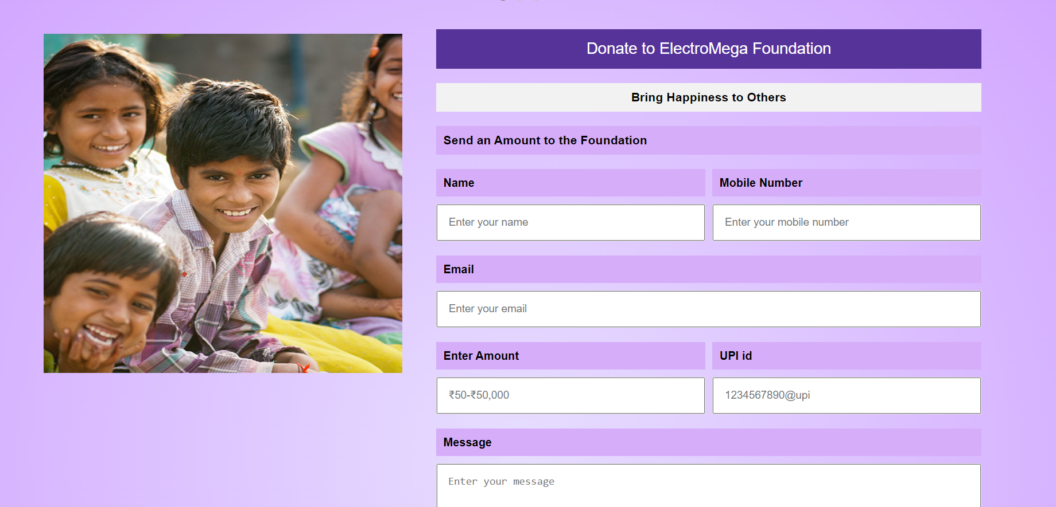
ElectroMega Foundation
ElectroMega Foundation - Empowering through Electronics
Our commitment to society goes beyond gadgets and gizmos. The ElectroMega Foundation Page is where you can make a difference. We believe in the power of technology to bring positive change. Here, you have the opportunity to enter any amount and date to contribute to charity. Join us in using the force of electronics for good. Your generosity can make a real impact
Technologies used - HTML, CSS and Javascript

Slide 13
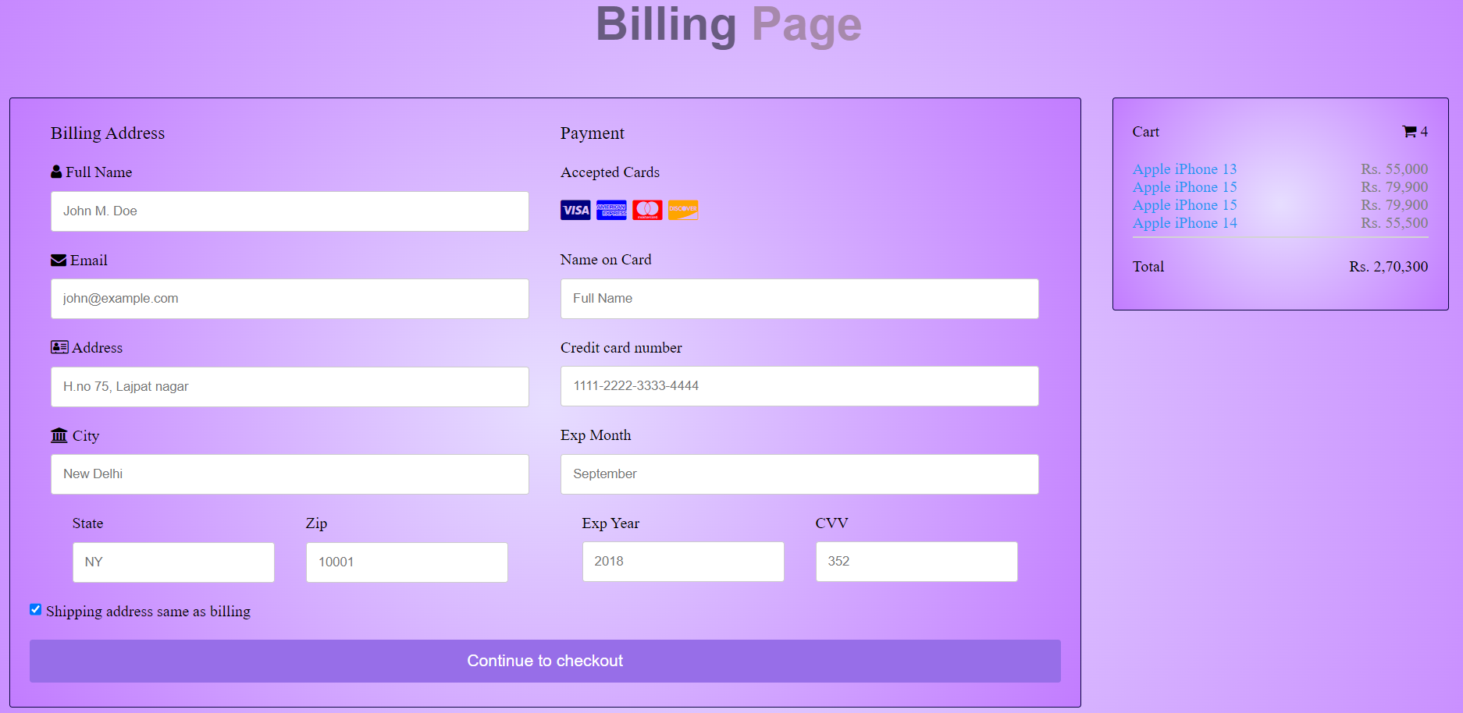
Checkout Page
The final step towards electronic bliss! Our Checkout Page streamlines the buying process for you. Confirm your selection, enter your payment details, and choose your preferred shipping method. It's fast, secure, and hassle-free. Complete your order with confidence, knowing that ElectroMega is here to provide you with a seamless and secure shopping experience.
Technologies used - HTML, CSS and Javascript

Slide 14
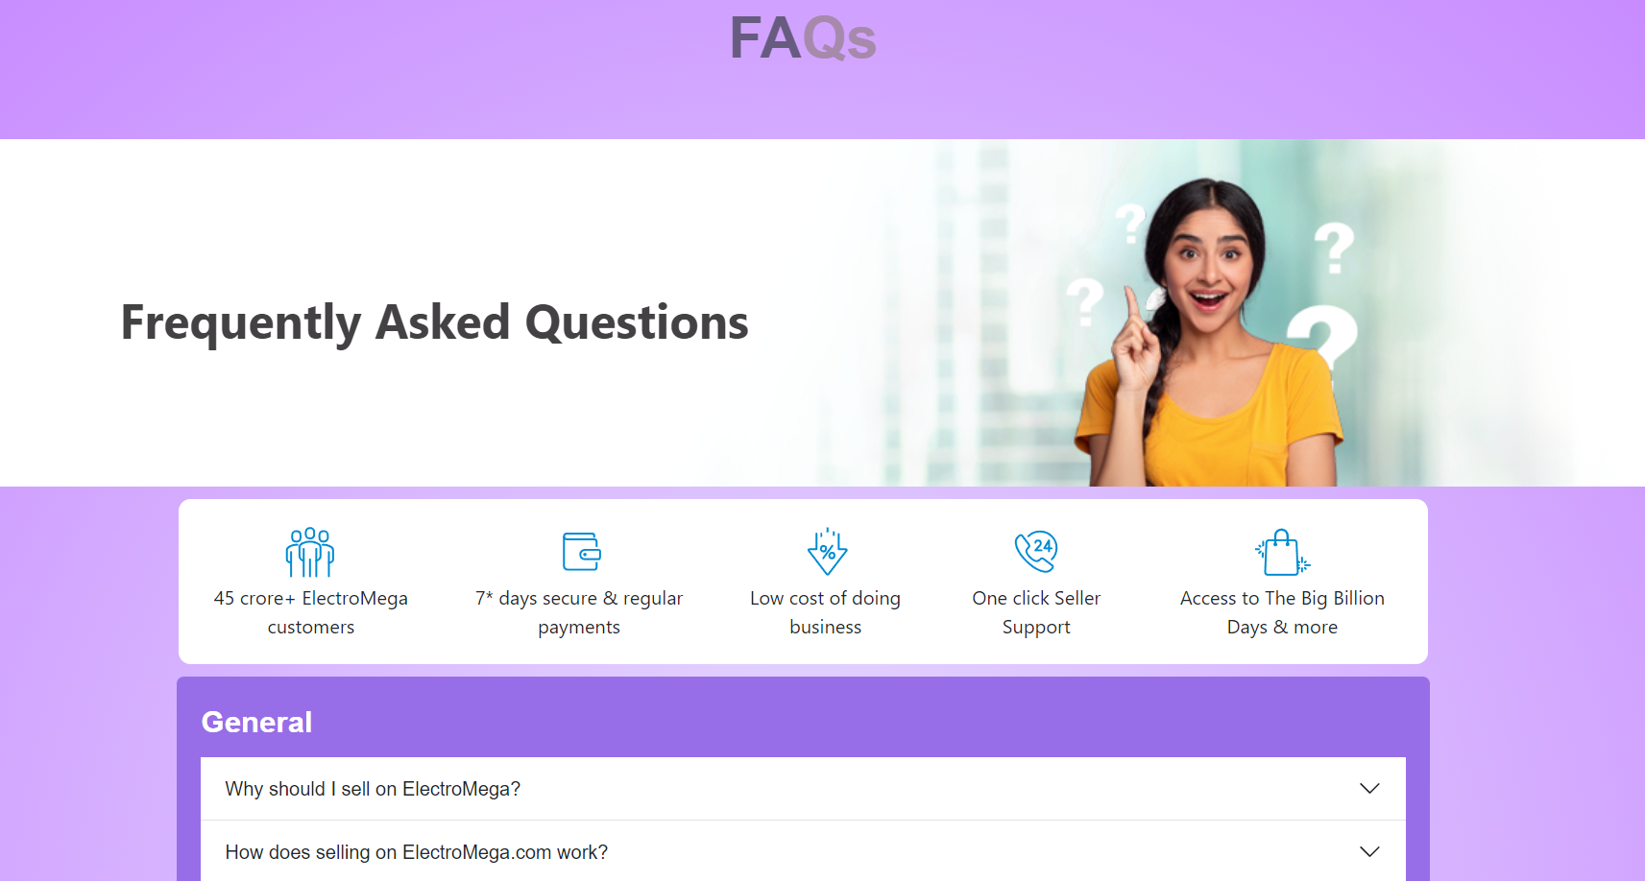
FAQ Page
Have Questions? We Have Answers!
Our FAQ page is your go-to resource for quick solutions. Find answers to commonly asked questions. We've compiled a comprehensive list to make your shopping experience as smooth as possible. If you can't find what you're looking for, feel free to reach out to our dedicated customer support team.
Use Accordions to show answer to user queries.
Technologies used - HTML, CSS, Bootstrap

Slide 15
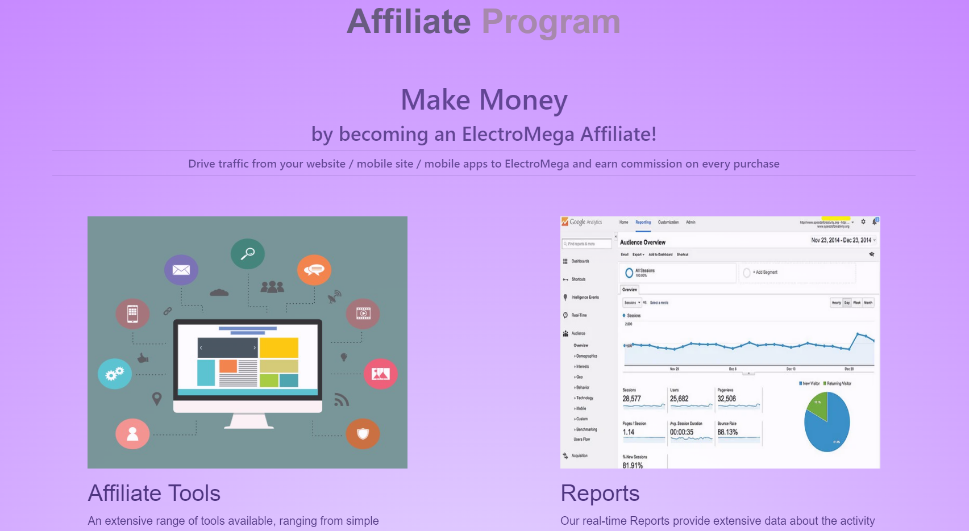
Affiliate Program Page
At ElectroMega, we believe in rewarding loyalty. Our Affiliate Program Page is your gateway to earning money while promoting top-notch electronics. Partner with us and share your passion for technology. Earn commisions for upto 6% by affiliate a great range of products.
Technologies used - HTML, CSS

Slide 16

Affiliate Program Page
Whatever your business model, ElectroMega Affiliate Program has an extensive range of tools available to help you improve your campaigns, ranging from simple banners & widgets to putting listings on your own site. You can also use the API to access ElectroMega's features and listings, and present them in a customized format.
Technologies used - HTML, CSS

Slide 17
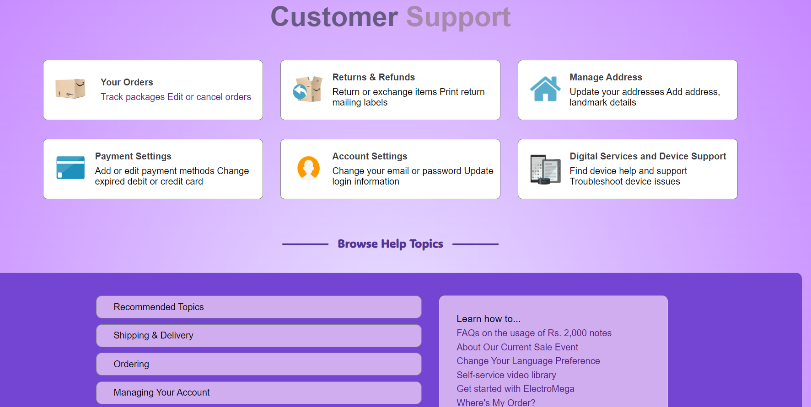
Customer Support Page
At ElectroMega, customer satisfaction is paramount. Our Customer Support Page is your direct line to our dedicated team. Whether you have questions, concerns, or need assistance, we're here to help. Contact us through various channels, including phone, email, or live chat.
Technologies used - HTML, CSS

Slide 18
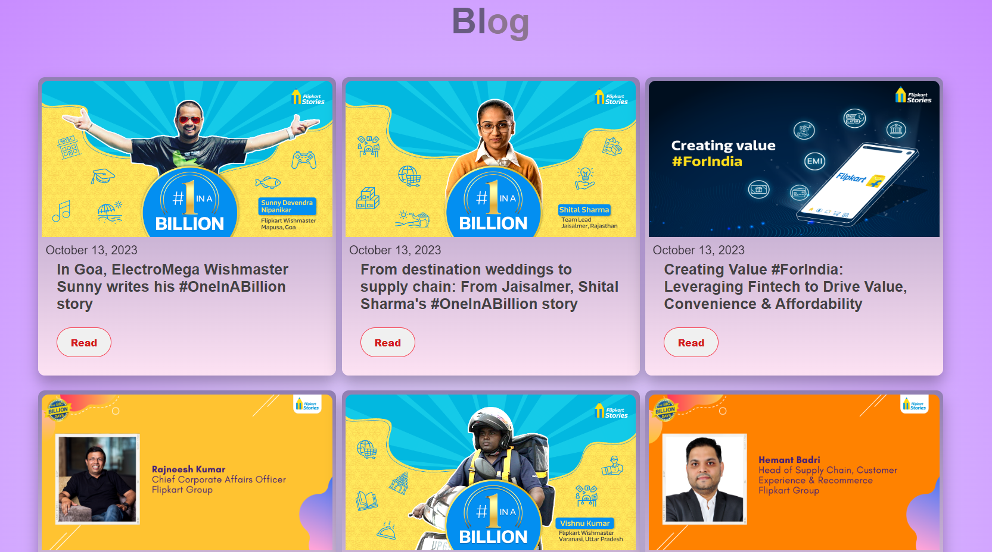
Blog Page
Discover the latest in the world of electronics on our Blog Page. Our tech-savvy writers bring you informative articles, product reviews, and industry insights. Whether you're looking for buying guides or staying updated on tech trends, our blog is your trusted source.
Technologies used - HTML, CSS

Slide 19
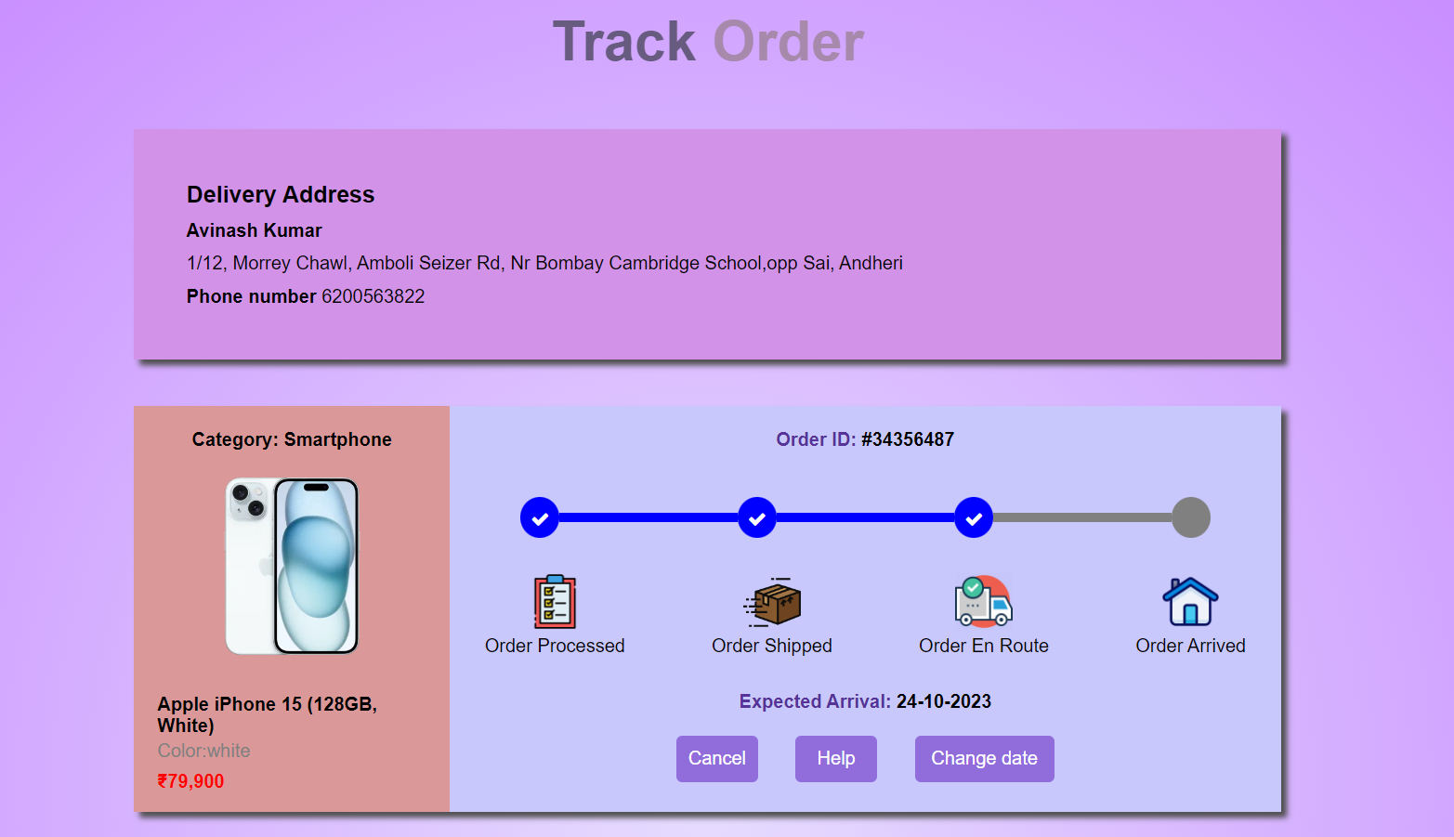
Order Tracking Page
ElectroMega keeps you in the loop every step of the way with our Order Tracking Page. Simply enter your order details, and you'll receive real-time updates on the status and location of your purchase. Know when your electronics will arrive and plan accordingly. Your convenience is our priority, and our order tracking page ensures you're always in control of your delivery.
Technologies used - HTML, CSS

Slide 20
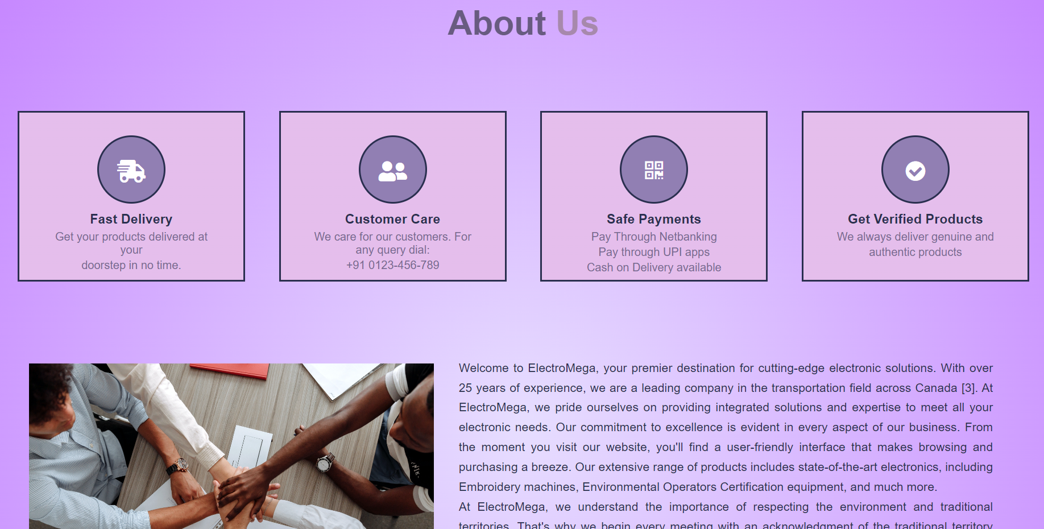
About Us Page
Our About Us Page is the story of ElectroMega's journey. We're more than just an electronics retailer; we're your trusted partner in all things tech. Learn about our mission, values, and commitment to excellence. With a rich history and a vision for the future, ElectroMega is here to provide you with the best in electronics.
Technologies used - HTML, CSS

Slide 21
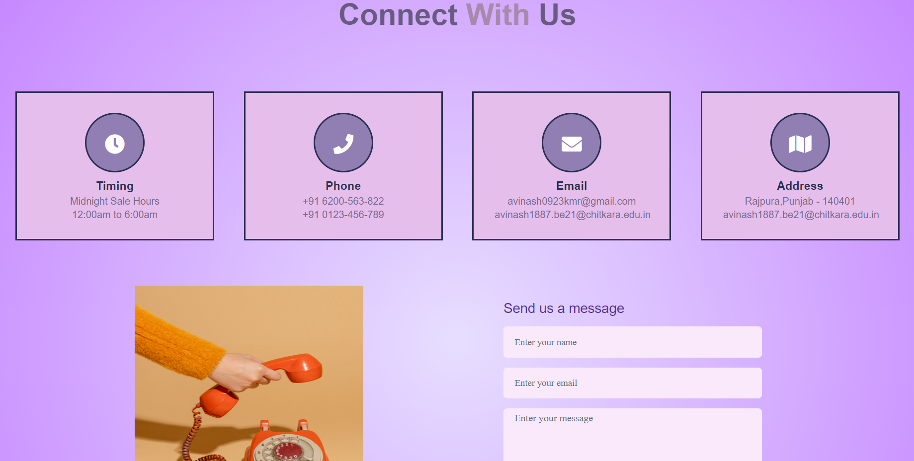
Contact Us Page
Our Contact Us Page is your direct link to our team. Whether you have questions, feedback, or inquiries, we're here to listen and assist you. Reach out through the provided contact form, email, or phone. Your input matters, and we're dedicated to providing you with the best possible support.
Technologies used - HTML, CSS

Slide 22
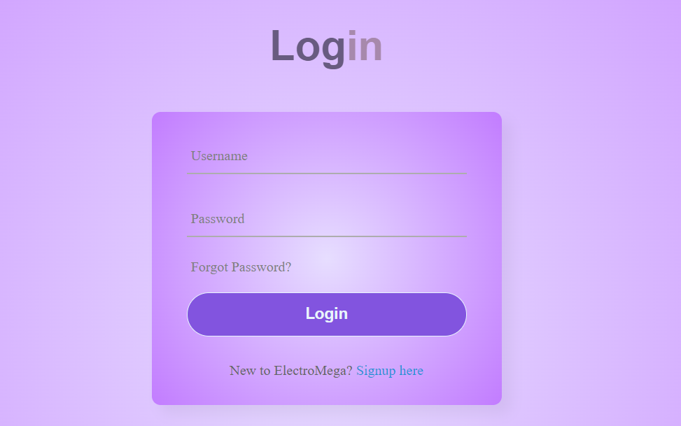
Login Page
Our Login Page is your gateway to a personalized shopping experience. If you're a returning customer, simply enter your credentials to access your account. Enjoy the convenience of saved preferences, order history, and a seamless checkout process.
Technologies used - HTML, CSS and Javascript

Slide 23
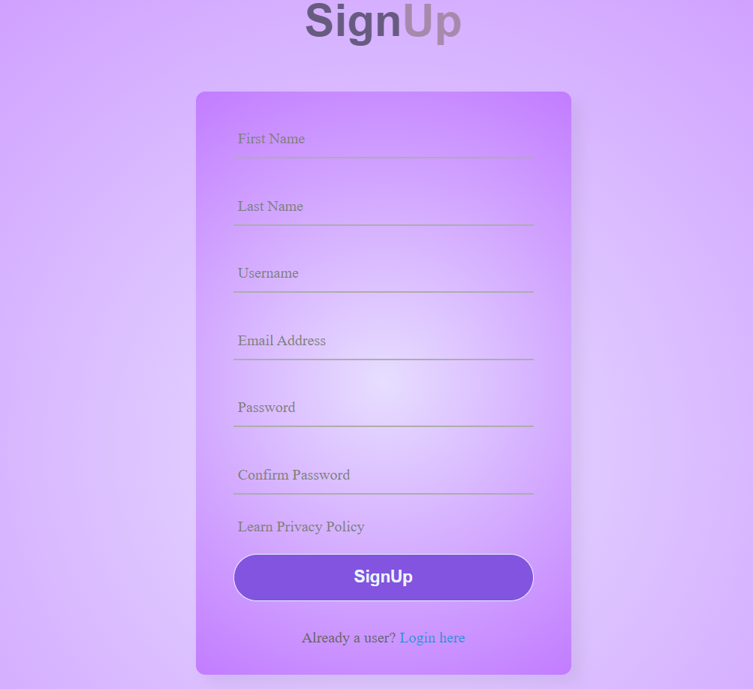
SignUp Page
Our Sign Up Page invites you to become a part of the ElectroMega community. Enjoy a personalized shopping experience, receive updates on the latest tech trends, and stay connected with us. Sign up today and embark on a tech-filled journey with ElectroMega.
Technologies used - HTML, CSS and Javascript

Slide 24


Conclusion
In conclusion, ElectroMega is your ultimate destination for all things electronic. Our goal is simple yet ambitious: to provide you with a seamless and enriching electronics shopping experience. We aim to offer a wide range of top-quality products, exceptional customer support, and valuable resources to keep you informed and inspired in the world of technology. Our commitment is to make your tech dreams come true. Thank you for choosing ElectroMega as your trusted electronics partner.

Slide 25
THANK YOU

